Slide 1


Notes:
SK 1 to 9
Laura & Saran 10 to 29
SK 30 to end

Slide 2

American Association of Orthodontists Foundation
Grant Application & Review Process
Workshop Goals
AAOF Mission & Achievements
Award Types & Eligibility Criteria
11 Required Components
Review Process & Criteria
Your & Your Mentors’/Chair’s Roles in Ensuring Your Success
Questions & Answers

Slide 3
American Association of Orthodontists Foundation
Grant Application & Review Process
Workshop Goals
AAOF Mission & Achievements
Award Types & Eligibility Criteria
11 Required Components
Review Process & Criteria
Your & Your Mentors’/Chair’s Roles in Ensuring Your Success
Questions & Answers

Slide 4
Workshop Goals
Share information on
  Award categories & requirements
  Review process, criteria & funding decisions
Improve
  Quality & completeness of applications
  Chances of your success
  Discovery & education in orthodontics
  Justification for fund-raising efforts of AAOF

Slide 5
AAOF Mission & Achievements
Mission
  Advance the orthodontic specialty by supporting quality education and research that leads to excellence in patient care
Since 1994
  $10.7 million in funding primarily Junior faculty
  225 Fellowship Awards & 222 Research Awards
>30% of Department Chairs & Program Directors supported by AAOF early in their academic careers
76% of faculty supported by AAOF awards remain in full-time academics after 5 years
http://www.aaofoundation.net

Slide 6
New to AAOF Application Submission
Call for proposals
  Business/Practice of Orthodontics
  Access/Barriers to Care
Biomedical Research Award
  Any full-time faculty in an Orthodontic Department
  ≥3 years in full-time academics
    Previous limit: 3-14 years

Slide 7
American Association of Orthodontists Foundation
Grant Application & Review Process
Workshop Goals
AAOF Mission & Achievements
Award Types & Eligibility Criteria
11 Required Components
Review Process & Criteria
Your & Your Mentors’/Chair’s Roles in Ensuring Your Success
Questions & Answers

Slide 8
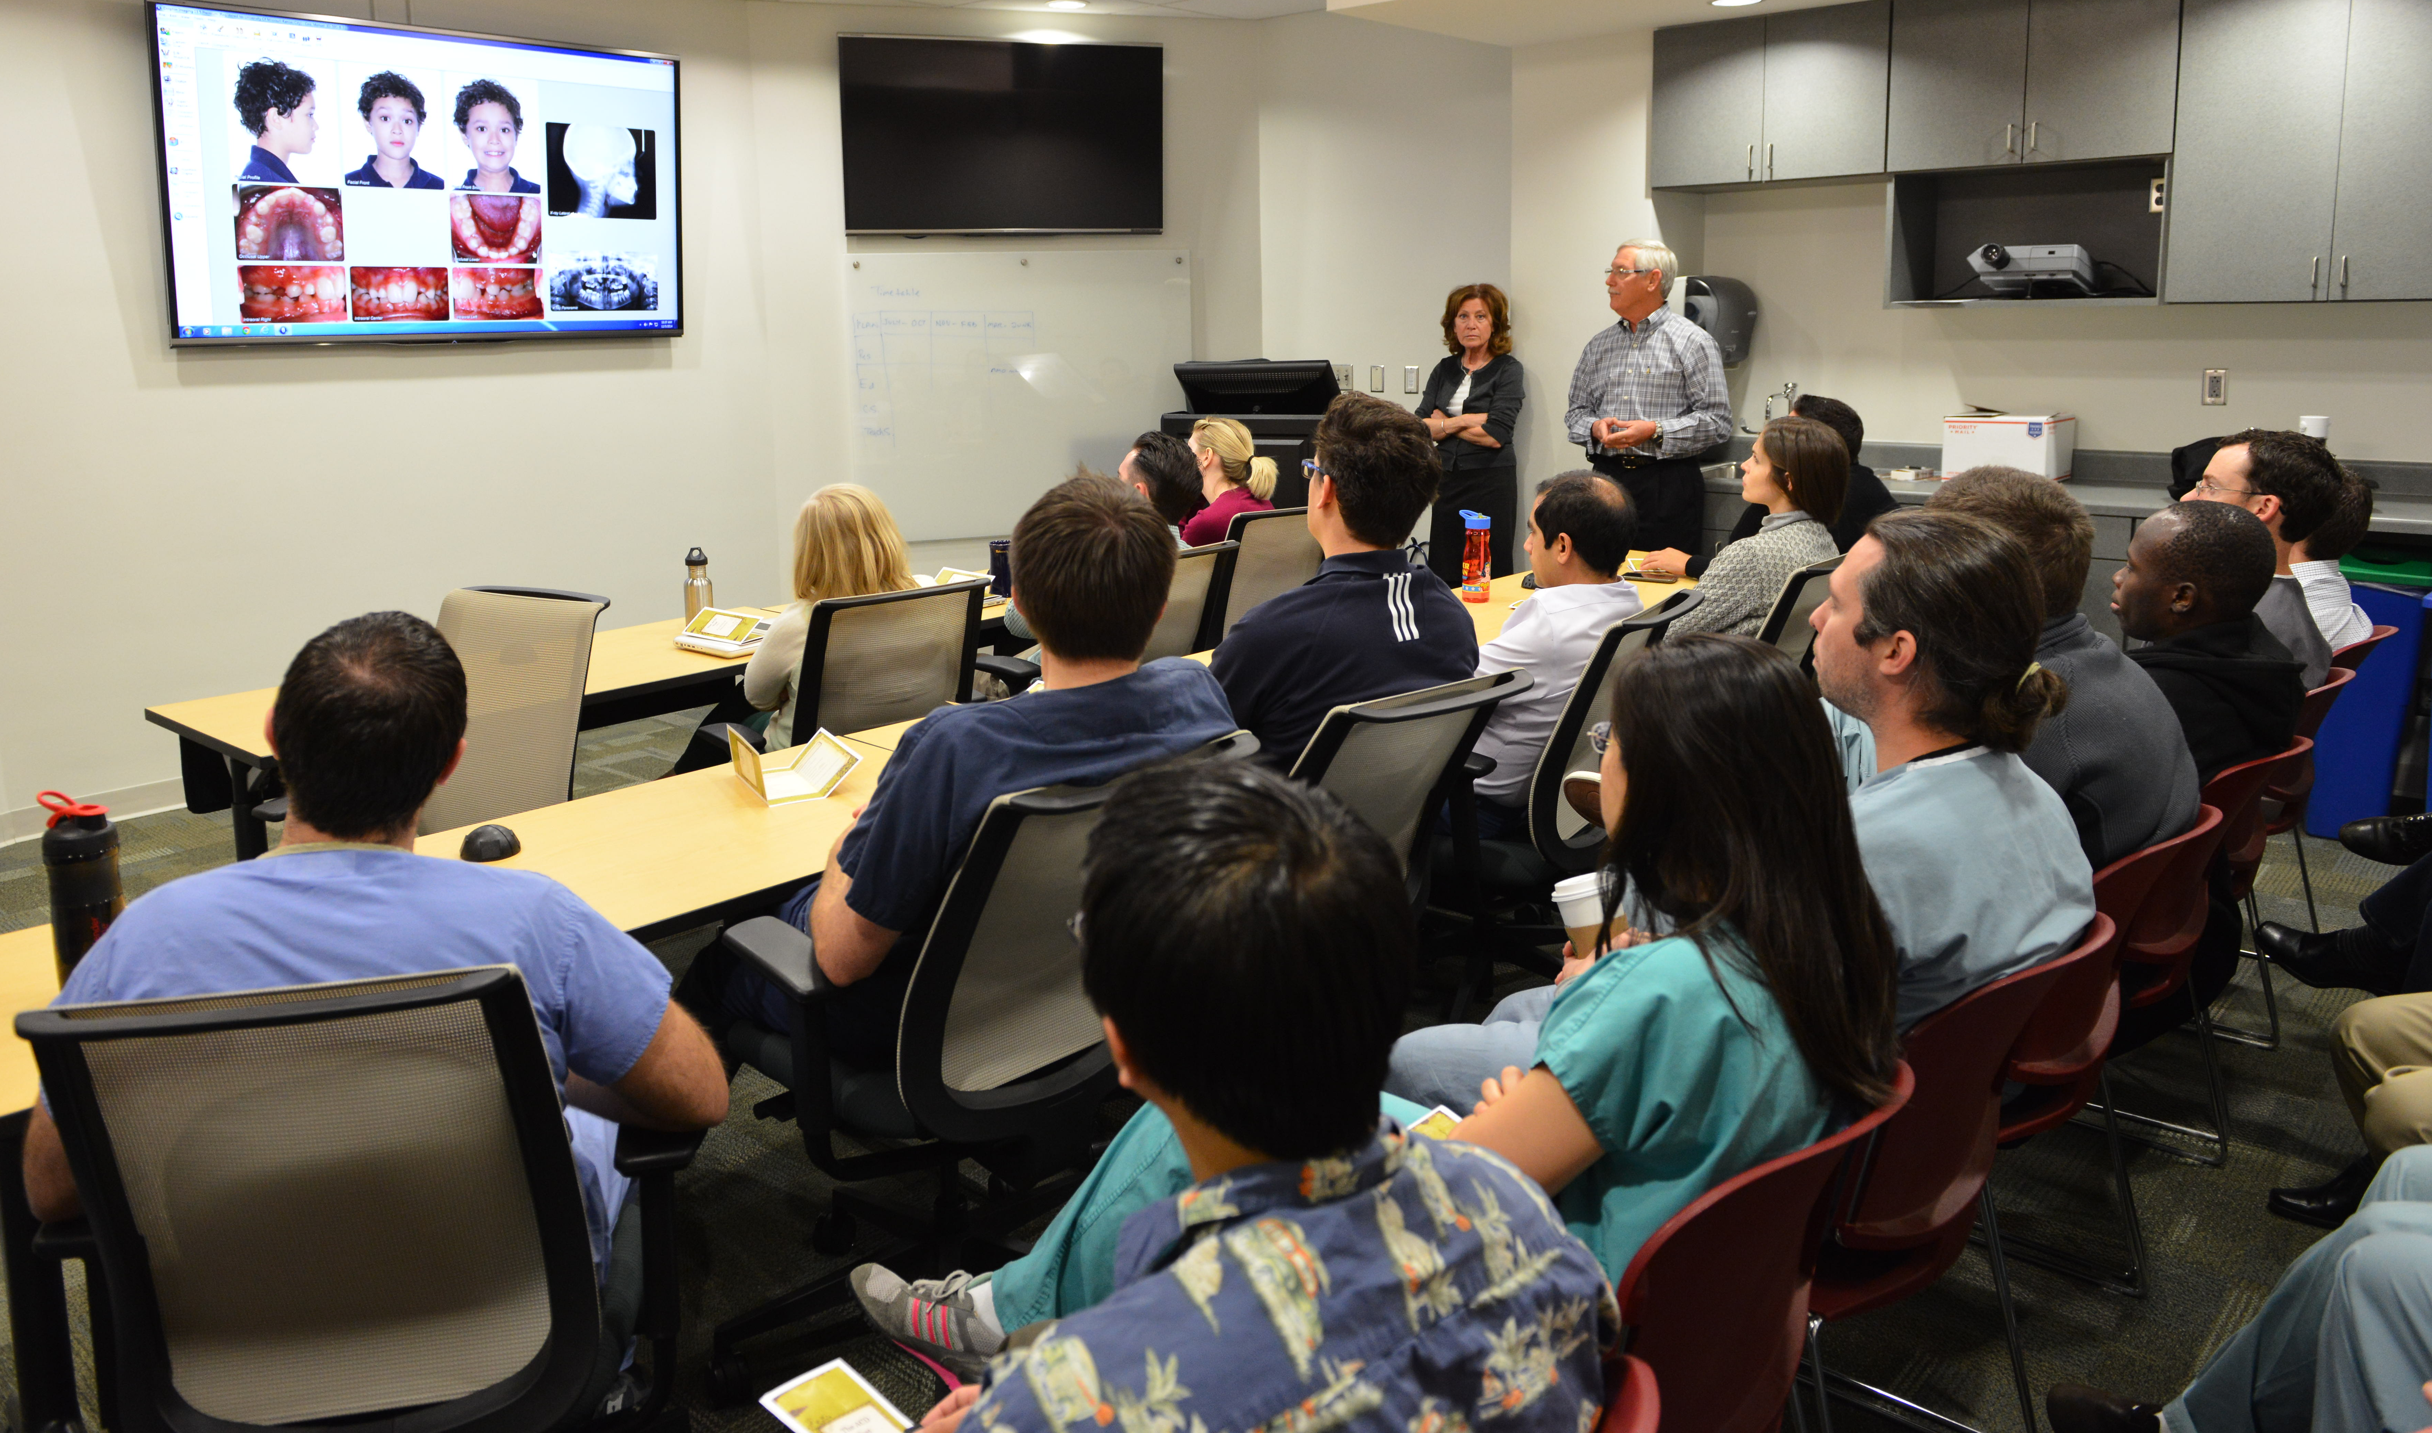
Award Types & Eligibility Criteria
All Award Categories
  US/Canadians, green-card holders/applicants
  Commitment to academic career (teaching/research)
Distinction between full-time, part-time and residents by Award category

Slide 9
Awards Not Offered in 2018
Education Innovation Award (EIA)
Program Award (PA) for support of workshops, symposia and lectures

Slide 10
AAOF Application Submission
On-line AND
Mail to AAOF
  One paper copy
  An electronic copy on a Thumb Drive/flashkey
All three identical copies to be received by December 15, 2017

Slide 11

Award Types & Eligibility Criteria
Support for Junior Faculty
  Orthodontic Faculty Development Fellowship Award (OFDFA)
    ≤$20,000 for one year
    Full-time faculty ≤5 years in 1st appointment
    TWO proposals per orthodontic program
  Postdoctoral Fellowship Award (PFA)
    ≤$50,000 per year for 2 years (with 3rd year possible)
    Orthodontist with PhD (or equivalent)
    For post-doc research training (lab or clinical)
    High potential for future extramural (NIH) funding
    Only one proposal per orthodontic program
Clipshrine.com

Slide 12
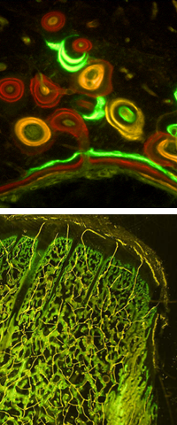
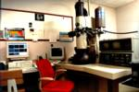
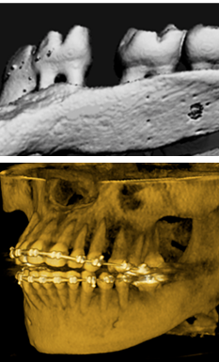
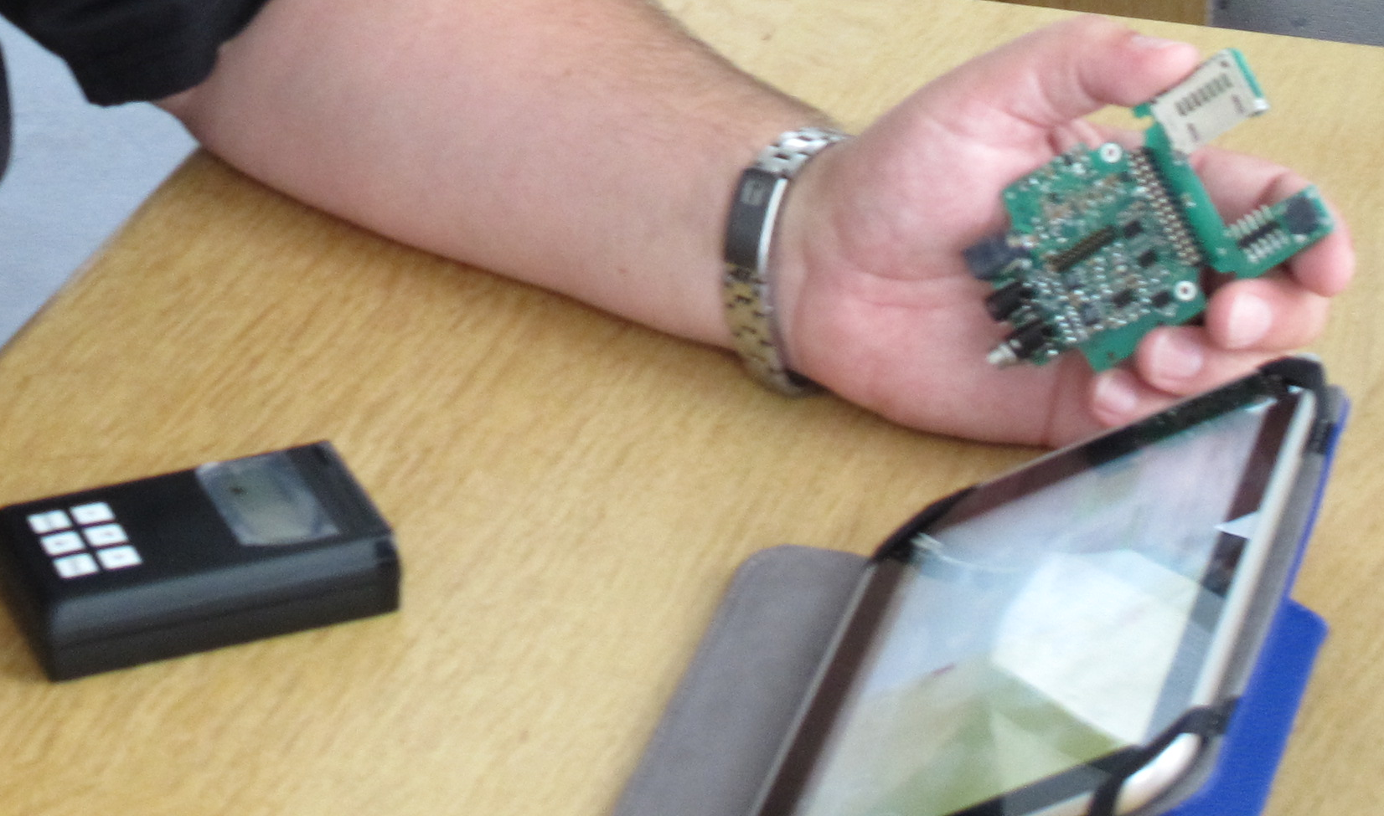
Award Types & Eligibility Criteria
Support for Orthodontic Faculty
  Biomedical Research Award (BRA)
    ≤$30,000 for one year
    Full-time faculty for ≥3 years
    Any rank
    Multiple applications per orthodontic program permitted

Slide 13
Award Types & Eligibility Criteria
Research Aid Award (RAA)
  ≤ $5,000 per year for one year
  Resident with commitment to part-time or full-time academic career – letter of support should state academic interest
  Or part-time (clinical) orthodontic faculty
  TWO proposals per orthodontic program
Center Award (CA)
  ≤ $25,000 per year for up to 3 years
  To enhance collaborations within and between institutions
  Four types
Clipshrine.com

Slide 14
Decision Tree:
Selecting the Right Award Category
I will be / am an orthodontic faculty
Full-time faculty
Part-time faculty
Very early to early career
(-) 0 to 5 years
≥3 years
Ortho Certificate ± MS + PhD
Ortho Cert + PhD or equiv
± Ortho Certificate ± MS + PhD
Ortho Certificate ± MS or PhD
Collaborations:
CA
PFA
OFDFA
BRA
RAA

Slide 15
11 Required Components
Application cover sheet
Table of Contents
Title Page
Documentation of Eligibility
Previous AAOF Awards & Outcomes
  Resubmissions only: Copy of previous AAOF Review
Budget & Budget Justification
Biosketches
Role of Applicant(s)
Proposed Plan
  Resubmissions only: Introduction Page
Letters of Support
Appendix
Yellow font implies that these are the same for all Award Categories

Slide 16
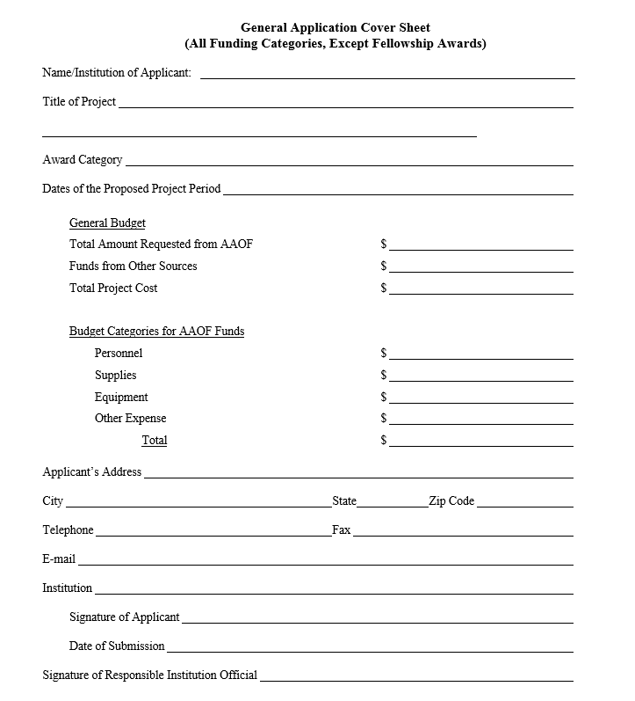
Required Component #1
Application Cover Sheet
Must be filled out, signed, & returned as application cover page
If AAOF funds requested only for part of total budget, state amount from other sources
Notes:
New pages pasted for all forms that have changed including those on subsequent pages

Slide 17
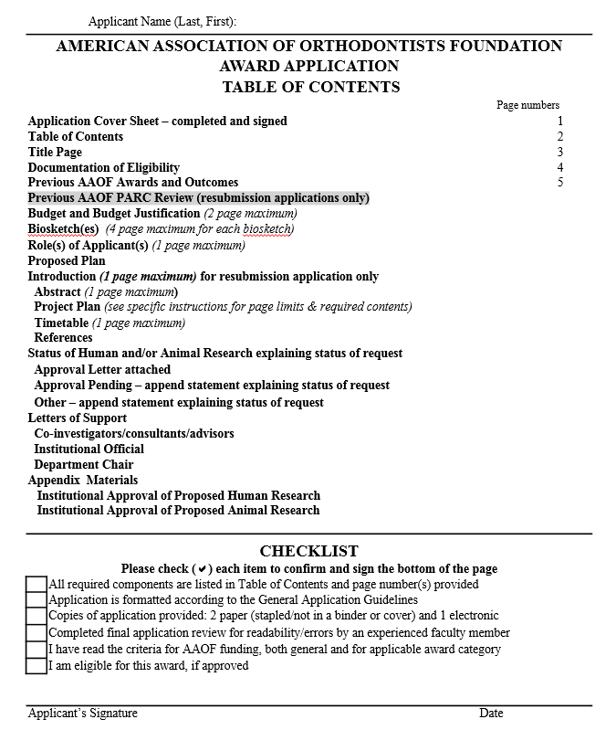
Required Component #2
Table of Contents & Checklist
Enter correct page numbers
All Checklist items must be confirmed
Attest to completeness of application by signing & dating

Slide 18
Required Component #3
Title Page
1-page maximum, include
  Award category/General/CFP
  Title of application
  All key personnel
    Include biosketches for all named (see #7)
  Other information specific to Award type
  Brief statement (1-3 sentences)
    Relevance of proposal to
      Clinical orthodontics
      Orthodontic education
    Use non-technical language

Slide 19
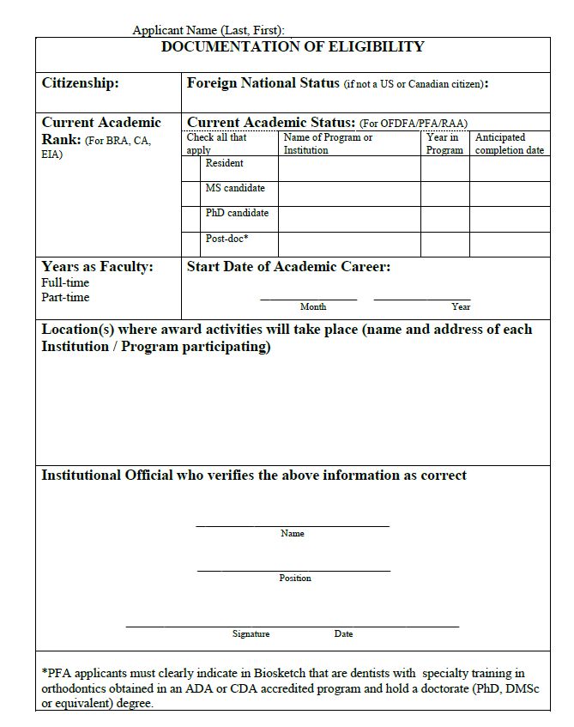
Required Component #4
Documentation of Eligibility
Citizenship, Foreign National Status
Current academic rank & years
Location(s) of activities
Verification by Institutional Official
  Department Chair
  Program Director or
  Dean

Slide 20
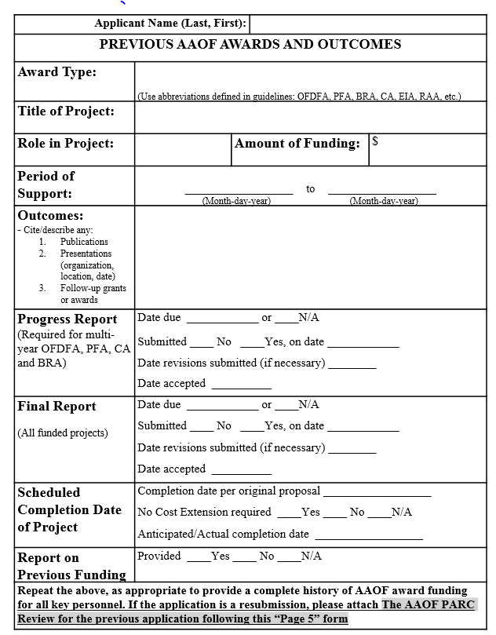
Required Component #5
Previous AAOF Awards & Outcomes
Reflects on:
  Academic accomplishments
  Success in career development and scholarship
  Future chances of success with additional funding
Important outcome measure for AAOF and donors

Slide 21
Required Component #5
Previous AAOF Awards & Outcomes
Resubmissions only:
  Attach a copy of your previous AAOF Review

Slide 22
Required Component #6
Budget & Budget Justification
All eligible expenses only
    Itemized list
    Justification or why needed
Ensure that you follow guidelines provided on eligible expenses (salaries) and limits (e.g. travel)
If AAOF funds only part of planned support, identify
    For which specific portion/s of proposal
    How remainder will be supported (agency, amount)
$$

Slide 23
Required Component #6
Budget & Budget Justification
Fellowships only
    Identify & describe alternative funds for Proposed Plans if all/part of funds are for salary support
Reviewers assess
    Appropriate for proposed activities
    Completeness
    Reasonable cost estimates
    Whether or not unbudgeted essential equipment, supplies, resources to perform studies are available
    Help them out!

Slide 24
Required Component #7
Biosketches
Include for all individuals named on Title Page
NIH biosketch ≤ 4 pages
  http://grants.nih.gov/grants/funding/phs398/phs398.html
  Personal statement
  Positions & honors
  Selected citations
  Research support (ongoing & past 3 years)

Slide 25

Required Component #8
Roles of Applicant(s) & Other Participants
Include all individuals named on Title Page
  Role(s)
  Responsibilities
  % effort
Follow specific instructions for Award type (e.g. OFDFA mentor role & associated details)
Openclipart

Slide 26
Required Component #9
Proposed Plan
Abstract (≤ 1 page)
Project Plan(s)
  Different page limits & content for different Award types
  Resubmissions only: Introduction page (see next slide)
Timetable (≤ 1 page)
References (no page limit)
  Include all cited materials

Slide 27
Resubmission Applications: #9-2
Applicant/s must
  Make appropriate & major changes to the re-submitted application
  Append previous AAOF PARC Review following Form Page 5
    i.e. after “Previous AAOF Awards & Outcomes” page/s
  Include 1-page Introduction in section 9-2 of Project Plan

Slide 28
Resubmission Applications: #9-2
Introduction (1 page maximum)
  Summarizes: substantial additions, deletions, & changes to the previous application
  Includes responses to all of the “weaknesses” provided in the six sections of the critique
  Should not exceed one page
  For e.g.: https://www.niaid.nih.gov/researchfunding/grant/documents/ratnerresplan.pdf

Slide 29
Required Component #10
Letters of Support
No page limits
Required for all Award categories
Award-specific instructions
Importance as specified in instructions
Avoid extraneous letters

Slide 30
Required Component #11
Appendix
No page limits
If applicable
  Human Research: IRB approval status
    Describe status
    Include notice if approved
  Animal Research: IACUC approval status
    Describe status
    Include notice if approved
Accepted & published manuscripts
  Not required
  ≤3 authored by applicant
  Directly relevant to application

Slide 31
OFDFA & PFA: Specifics
Project Plans
  Page limits
    OFDFA ≤6 pages
    PFA ≤10 pages
4 Developmental Plans:
  Required: Programs & activities
  Educational
  Clinical skills
  Teaching skills
  Research
Area/s of emphasis
  OFDFA: One or more
  PFA: Research must be focus
Provide
  Sufficient detail for evaluation
  Note: History/previous accomplishments ≠ Plans
  Key Advisors for each Developmental Plan
    Should review and mentor on application prior to submission
    Provide letter of support

Slide 32
OFDFA & PFA: Specifics
Letters of Support
  Page limits: None
  At least 3 supporting letters
    Describe abilities/future potential, qualifications re: goals of OFDFA or PFA
  Individuals named on Title Page
    Principal advisor(s)/mentor(s), Co-I(s), Consultant(s)
    Verify participation, plans for support
  Institutional official
    Verify support of/resources for 4 Developmental Plans
  Chair
    Verify eligibility, support & time
    Confirm appointment as FT faculty as of July 1 of funding period

Slide 33
OFDFA & PFA: Other Info
TWO OFDFA & ONE PFA proposal per orthodontic program
PI may apply for both OFDFA & PFA
  Only 1 will be funded
Current residents may apply if have
  FT faculty position starting July 1st of funding year
  Verification of appointment required from chair

Slide 34
BRA & RAA: Specifics
Project Plans
  Page limits
    ≤ 10 pages for BRA
    ≤ 5 pages for RAA
  Background & Significance
  Preliminary Studies
  Experimental Design, Methods & Statistical Analyses
  Expected Outcomes
  Alternative Approaches
    What if outcomes are not as expected?
    How to trouble-shoot
    Demonstrate that all aspects been considered

Slide 35
BRA & RAA: Specifics
Letters of Support
  Page limits: None
Co-I(s), Consultant(s)
  Individuals named on Title Page
  Verify participation, plans for support
Institutional official
  Verify support of/resources for Project Plan
Chair’s letter
  BRA
    Verify eligibility, support & time
    Confirm ≥3 years as FT faculty as of July 1 of funding period
  RAA
    PT faculty may apply
    Residents
      Evidence of resident’s strong interest in a future academic career must be highlighted in letter
      Verify support for applicant & time remaining in residency program to complete the project

Slide 36
BRA: Other Info
Investigator-initiated research
  Orthodontics & related topics
  Expected to lead to
    Publications
    Preliminary data: external grant applications (e.g. NIH)
  Scientific merit emphasized
No limit: # of proposals per orthodontic program
PI may
  Apply for both BRA & PFA - only 1 will be funded
  Can not apply if PI/Co-PI on another application

Slide 37
Center Award
Four types
  Establishing a “center” of investigation
  Supporting an established “center” of investigation
  Support of special collections & databases
  Support of collaborative inter-institutional symposia / workshops to expedite discoveries & technology transfer
Project Plan ≤ 10 pages
Content depends on Type 1 to 4
Need to demonstrate
  Genuine cooperative and collaborative undertaking
  Not merely an expanded BRA

Slide 38
American Association of Orthodontists Foundation
Grant Application & Review Process
Workshop Goals
AAOF Mission & Achievements
Award Types & Eligibility Criteria
11 Required Components
Review Process & Criteria
Your & Your Mentors’/Chair’s Roles in Ensuring Your Success
Questions & Answers

Slide 39
Process for Award Application, Review & Funding
AAOF Executive VP and Staff
> All administrative aspects of AAOF Fund Raising & Grant Administration
> Only contact for Applicants
> Address all inquiries from applicants
AAOF PARC
> 8 member panel (ad hoc if needed)
> Reviews & scores grants
> Recommends grants for funding
> Recommends revisions or new funding mechanisms
AAOF BOD
> Establishes fund raising priorities & approaches
> Undertakes fund raising
> Makes decisions on recommendations made by PARC
Applicant & Institution
> Apply for funding & perform proposed activities
> Agree to Terms
> Provide progress & final reports
PARC: Planning and Awards Review Committee
BOD: Board of Directors

Slide 40
The Process Flow
AAOF Executive VP and Staff
  AAOF Awards materials issued
  Receives all applications
  Reviewed by AAOF staff for meeting deadline, eligibility and completeness
  Incomplete, ineligible or late applications triaged
PARC
  Chair assigns applications to PARC members generally based on area(s) of expertise
  Applications scored initially by 2 reviewers using specific scoring criteria
  Written reviews and preliminary overall impact scores (scale of 1 to 9)
  Additional reviewers sought when scores vary by more than 2 points
  PARC meeting- reviews presented with preliminary scores and discussed; final scores provided by all reviewers; final scores by all PARC members; average final score plus review collated
  Makes funding recommendations to AAOF BOD on basis of funding available and quality of applications
AAOF BOD makes final funding decisions
AAOF Executive VP communicates funding decision and grant critique

Slide 41

Review Criteria
Overall Impact
  Scale of 1 to 9
  Based on following criteria
Scored Review Criteria
  Significance
  Investigator(s)
  Innovation
  Approach
  Environment including mentors & resources
  Success and Productivity of Previous Funding Provided
Strengths and Weaknesses (major, moderate, minor)
Additional Review Criteria
  Human or Animal Research Approval Status
  Budget
    Appropriate & justified
    Ineligible requests
http://peter.baumgartner.name/2014/05/23/double-blind-review-ein-fallbeispiel/

Slide 42
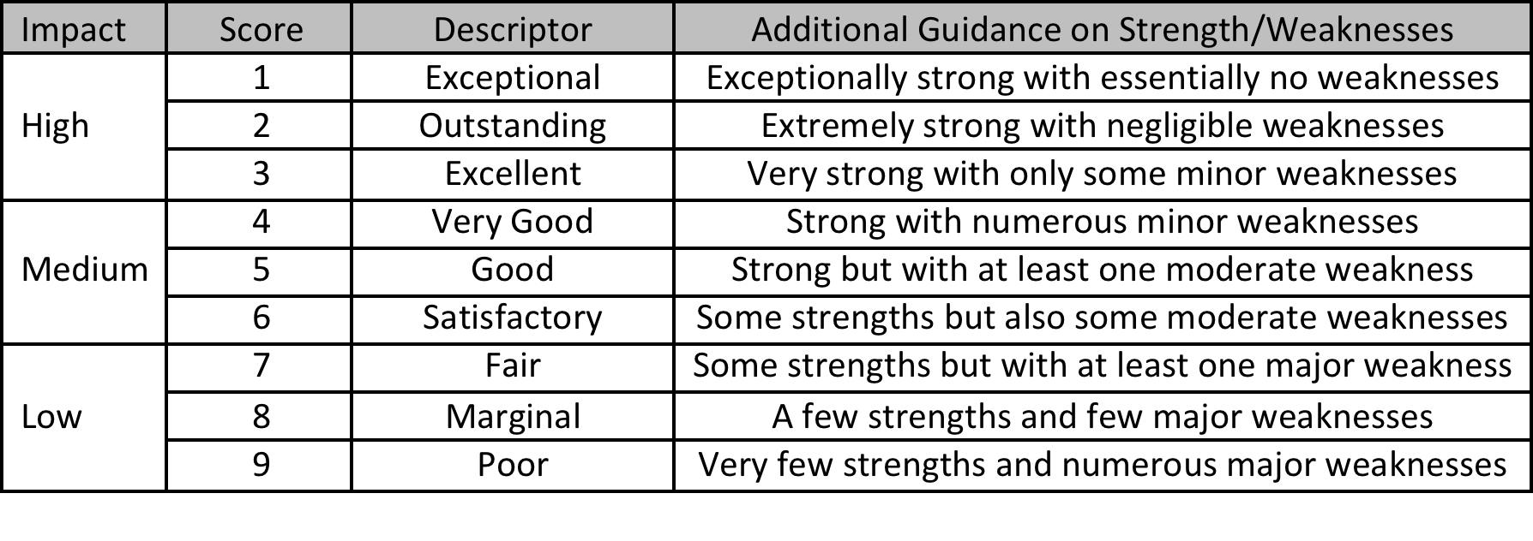
Scoring Scale & Guidelines

Slide 43
American Association of Orthodontists Foundation
Grant Application & Review Process
Workshop Goals
AAOF Mission & Achievements
Award Types & Eligibility Criteria
11 Required Components
Review Process & Criteria
Your & Your Mentors’/Chair’s Roles in Ensuring Your Success
Questions & Answers

Slide 44
Where Do Applicants Trip Up
Quality of application
  How strong is it in each of the criteria?
  Is it proposing novel ideas and approaches?
Formatting & completeness of application
  Did you submit by the deadline?
  Did you follow the instructions diligently?
  Are all required materials included?
  If this is resubmission of a previous non-AAOF grant has this been formatted to the AAOF guidelines?
Award category
  Are you eligible for the Awards category for which you have applied?
  Is this the Award category in which you are most competitive?

Slide 45
Where Do Applicants Trip Up
Mentorship & Consultants
  If grant is poorly compiled or question is weak or dated, it reflects on potential for inadequate or weak mentorship
  Seek strong, relevant mentors
  Seek input early and often
Accomplishments from prior funding
  Did you achieve the goals of your previous funding?
  Have you filed your reports with AAOF?

Slide 46
Best Practices
Start 6 months prior to submission
Research
  Define excellent & novel questions and experimental design, contemporary methodologies
  Provide any preliminary data to support your ideas
For career development
  Seek out newer approaches to designing curriculum and teaching methods
  Take relevant courses, workshops and classes

Slide 47
Best Practices
Mentorship
  Strong, supportive and dedicated mentorship in research, teaching and career development
Application Refinements
  Present and discuss your proposals with your mentors and consultants frequently, have them read and revise them
Have you done all your own work?
  Complete well organized proposal
  Attention to detail
  Make it easy for the reviewers
  Will reviewers have to look everywhere to dig up the needed information? Place content where it should be

Slide 48
Awards Types for 2018
Junior Faculty
  OFDFA
  PFA
BRA
  ≥3 years of full-time academics
Center Award
Research Aid Award
Changes for 2018 only for the following:
  Expansion of the BRA to include Senior Faculty
  Call for Proposals:
    Business/Practice of Orthodontics
    Barriers/Access to Care

Slide 49
The Future
Continue building on
  Quality of applications
  Discoveries in orthodontics
  Faculty development successes
Continue enhancing quality of review and feedback
Implementation of new AAOF Strategic Plan

Slide 50

Thank You

Slide 51
American Association of Orthodontists Foundation
Grant Application & Review Process
Workshop Goals
AAOF Mission & Achievements
Award Types & Eligibility Criteria
11 Required Components
Review Process & Criteria
Your & Your Mentors’/Chair’s Roles in Ensuring Your Success
Questions & Answers

