Slide 1
AAOF Workshop:
SUBMITTING A SUCCESSFUL
AAOF AWARD APPLICATION
Presented by: Dr. Saran Huja
Dr. Sath Allareddy
Dr. Sylvia Frazier-Bowers
Dr. Wanda Claro
Friday June 16, 2023
11:00 a.m. - 1:00 p.m. CT
https://www.aaofoundation.net

Slide 2
Guide to the 2024 Cycle for Applicants & Mentors
Workshop Goals
AAOF Mission & Achievements
Award Types & Eligibility Criteria
11 Required Components
Review Process & Criteria
Your Role & Your Mentors’/Chair’s Roles in Ensuring Your Success
Questions & Answers

Slide 3
Workshop Goals
Share information on
Award categories & requirements
Review process, criteria & funding decisions
Improve
Quality & completeness of applications
Chances of your success
Discovery & education in Orthodontics
Justification for fundraising efforts of AAOF

Slide 4
Mission:
To advance the orthodontic specialty by supporting quality education and research that leads to excellence in patient care and by promoting orthodontic charitable giving. AAOF funding ensures the future viability of the specialty by investing in the next generation of educators and researchers.
Mission & Achievements
Since 1994:
The AAOF has funded over 500 fellowship and research awards totaling $15.6 million
76% of faculty supported by AAOF awards remain in full-time academics after 5 years
For 2023, the foundation received 46 proposals and
approved 29 for funding

Slide 5
Calls for Proposals*
- update for 2024
Business of Orthodontic Practice
Study Impending Issues In Orthodontic Practice

Slide 6
Funding for the
2024 cycle
Funding amounts for the following
OFDFA – $30,000 with a cap on salary of $20,000
BRA – $40,000
RAA – $6,000
CA – $25,000 per year; maximum of 3 years. (Type 4 CA, $50,000 max – see CA General Description)
PFA – $50,000 per year; maximum of 2 years. (One proposal per year per program)
PARC application deadline moved to October 13, 2023

Slide 7
Guide to the 2024 Cycle for Applicants & Mentors
Workshop Goals
AAOF Mission & Achievements
Award Types & Eligibility Criteria
11 Required Components
Review Process & Criteria
Your Role & Your Mentors’/Chair’s Roles in Ensuring Your Success
Questions & Answers

Slide 8
Award Types & Eligibility Criteria
All Award Categories
Commitment to academic career (teaching/research)
US/Canadian institutions
Fellowships (OFDFA, PFA), BRA, CA
US/Canadian citizens
Green-card holders/applicants
Distinction between full-time, part-time and residents by Award category

Slide 9
New Application
Submission Process
Our new application website is online at https://www.grantinterface.com/Home/Logon?urlkey=aao
If you are new to the system, you will Create New Account or if you are a previous user, log into the system using your previous information. Then you will be on the Apply page and can choose the appropriate category. Use the same email and password each time you log in.
Applications will automatically save. You can log out and log back in at any time to complete the application before the deadline. Once you are finished, click the Submit button.
You cannot change your application after it has been submitted.

Slide 10
Award Types & Eligibility Criteria: Junior Faculty
Orthodontic Faculty Development Fellowship (OFDFA)
≤$30,000 for one year
Full-time faculty ≤5 years in 1st appointment
Postdoctoral Fellowship (PFA)
≤$50,000 per year for 2 years (with 3rd year possible)
Orthodontist with PhD (or equivalent)
For post-doc research training (lab or clinical)
High potential for future extramural (NIH) funding
Only one proposal per orthodontic program

Slide 11
Award Types & Eligibility Criteria: Experienced Faculty
Biomedical Research Award (BRA)
≤$40,000 for one year
Full-time faculty for ≥3 years
Any rank
Multiple applications per orthodontic program permitted
Now eligible: Cleft/Craniofacial Orthodontists
Full-time
Teaching commitment (stated in LOS)
ACPA-accredited Team

Slide 12
Award Types & Eligibility Criteria: Residents/PT Faculty
Research Aid Award (RAA)
≤$6,000 per year for one year
Criteria
Resident committed to part-time/full-time academic career
Letter of support should state academic interest in 1st/2nd year
≥1 year from start of award (7/3/2024) to complete project
Not a previous RAA recipient
Part-time orthodontic faculty

Slide 13
Award Types & Eligibility Criteria: Collaborations
Center Award (CA)
≤$25,000 per year for up to 3 years
No seniority limit
To enhance collaborations within and between institutions
Four types

Slide 14
Decision Tree:
Selecting correct award category
I will be / am Orthodontic Faculty
Full-time
Part-time OR Resident
who will become Faculty
Early
≤5 years
Experienced
≥3 years
CA
RAA
Collaborations
PFA
Cert Ortho + PhD or equivalent
OFDFA
BRA
Cert Ortho ± MS, PhD
± Cert Ortho, MS, PhD

Slide 15
Questions?
aaofoundation.net

Slide 16
The following are some helpful suggestions in completing your application

Slide 17
Previous AAOF Awards
and Outcomes
Reflects on:
Academic accomplishments
Success in career development and scholarship
Future chances of success with additional funding
Important outcome measure for AAOF and donors

Slide 18
Budget & budget justification
All eligible expenses only
Itemized list
Justification: why needed
Follow guidelines – especially re: what is allowed (± salaries) and limits (travel)
If other funds are planned to complete proposal, identify
What parts will be funded by AAOF/other funds
Must: Source of other funds (agency, amount)

Slide 19
Budget & budget justification
Fellowships only – if requesting stipend/salary
Describe alternative funds (sources, amounts) for proposed plans
Reviewers assess
Appropriateness for proposed activities
Completeness
Reasonable cost estimates
If not in budget, are essential equipment, supplies, resources available to perform studies/plans
Help out: provide information

Slide 20
Bio Sketches
Required for all individuals named on Title Page
≤4 pages
Personal Statement
Positions and Honors
Contribution to Science
Research support
Ongoing
Past 3 years

Slide 21
Roles of Applicant(s)
Include all individuals named on Title Page
Role(s)
Responsibilities
% effort
Follow award-specific instructions, e.g.
OFDFA mentor/advisor(s)
Role/s
Plans for meetings with applicant
Skills, background

Slide 22
Proposed Plan
Abstract (≤1 page)
Project Plans(s)
Different page limits & content for different award types
Resubmissions only: Introduction page (see next)
Timetable (≤1 page)
References (no page limit)
Include all cited materials

Slide 23
Resubmission Applications: Introduction Page
Resubmissions are encouraged
Applicant/s must
Make appropriate & major changes to the re- submitted application
Include previous AAOF PARC review

Slide 24
Resubmission Applications: Introduction Page
1 page maximum
Summarizes:
Substantial additions, deletions, & changes to the previous application
Includes:
Responses to all of the “weaknesses” provided in the six sections of the critique

Slide 25
Letters of Support
No page limits
Required for all award categories
Award-specific instructions
Importance as specified in instructions
Avoid extraneous letters

Slide 26
Appendix
No page limits
If applicable
Human Research: IRB approval status
Describe status
Include notice if approved
Animal Research: IACUC approval status
Describe status
Include notice if approved
Accepted & published manuscripts
Not required
≤3 authored by applicant
Directly relevant to application

Slide 27
Questions?

Slide 28
OFDFA & PFA: Specifics
Project Plans - Page limits
OFDFA ≤6 pages
PFA ≤10 pages
4 Developmental Plans:
Required (programs, activities)
Educational
Clinical skills
Teaching skills
Research
Orthodontic Faculty Development Fellowship Award
Postdoctoral Fellowship Award

Slide 29
OFDFA & PFA: Specifics
Letters of Support -Page limits: None
At least 3 supporting letters: choose references who can
Describe abilities/future potential, qualifications re: goals of OFDFA or PFA
Individuals named on Title Page
Principal advisor(s)/mentor(s), Co-I(s), Consultant(s)
Verify participation, plans for support
Institutional official
Verify support of/resources for 4 Developmental Plans
Chair
Verify eligibility, support & time
Confirm appointment as FT faculty as of July 1 of funding period
Orthodontic Faculty Development Fellowship Award
Postdoctoral Fellowship Award

Slide 30
OFDFA & PFA: Specifics
Project Plans – Areas of emphasis
OFDFA: 1 or more
PFA: Research must be focus
Provide
Sufficient detail for evaluation
Note: History/previous accomplishments ≠ Plans
Key Advisors for each Developmental Plan
Should review, mentor on application prior to submission
Provide letter of support
Orthodontic Faculty Development Fellowship Award
Postdoctoral Fellowship Award

Slide 31
OFDFA & PFA: Other Info
Proposals allowable per orthodontic program
1 PFA
PI may apply for both OFDFA & PFA
Only 1 will be funded
Current residents may apply if they have
FT faculty position starting July 1st of funding year
Verification of appointment required from chair
Orthodontic Faculty Development Fellowship Award
Postdoctoral Fellowship Award

Slide 32
OFDFA & PFA: Other Info
“Stipend” (cash gift) for salary support
Allowed by the AAOF for OFDFA & PFA only
Note: Some institutions will not allow additional income as “salary”
Other options if this is not allowed by your institution
Separate LOAs for institution AND PI
Need institutional official to sign both LOAs
IF not possible, suggest re-designing budget and justifications
Orthodontic Faculty Development Fellowship Award
Postdoctoral Fellowship Award

Slide 33
BRA & RAA: Specifics
Project Plans
Page limits
≤ 10 pages for BRA
≤ 5 pages for RAA
Background & Significance
Preliminary Studies
Experimental Design, Methods & Statistical Analyses
Expected Outcomes
Alternative Approaches
What if outcomes are not as expected?
How to trouble-shoot
Demonstrate that all aspects have been considered
Biomedical Research Award
Research Aid Award

Slide 34
BRA & RAA : Specifics
Letters of Support - Page limits: None
Individuals named on Title Page
Co-I(s), Consultant(s): Verify participation, plans for support
Institutional official
Verify support of/resources for Project Plan
Chair - Verify eligibility, support & time
BRA: Confirm ≥3 yrs as FT faculty as of July 1 of funding period
Cleft/Craniofacial Orthodontists: confirm teaching activities
RAA
Resident:
Highlight strong interest in a future academic career
Time to complete project while in program
PT faculty
Biomedical Research Award
Research Aid Award

Slide 35
BRA: Other Info
Investigator-initiated research
Orthodontics & related topics
Expected to lead to
Publications
Preliminary data: external grant applications (e.g., NIH)
Scientific merit emphasized
No limit: # of proposals per orthodontic program
PI may
Apply for both BRA & PFA - only 1 will be funded
Cannot apply if PI/Co-PI on another application in same or other category
Biomedical Research Award
Research Aid Award

Slide 36
Center Award
Four types – support for
Establishing a “center” of investigation
Established “center” of investigation
Special collections & databases
Collaborative inter-institutional symposia / workshops to expedite discoveries & technology transfer
Project Plan ≤10 pages
Content depends on Type 1 to 4
Need to demonstrate
Genuine cooperative and collaborative undertaking
Not merely an expanded BRA
Center Award

Slide 37
Guide to the 2024 Cycle for Applicants & Mentors
Workshop Goals
AAOF Mission & Achievements
Award Types & Eligibility Criteria
11 Required Components
Review Process & Criteria
Your Role & Your Mentors’/Chair’s Roles in Ensuring Your Success
Questions & Answers

Slide 38
Application, Review & Funding Processes
AAOF Senior VP & Staff
All administrative aspects
Fundraising & grant administration
Only contact for Applicants
Address all inquiries from applicants
Applicant & Institution
Apply for funding & perform proposed activities
Agree to Terms
Provide progress & final reports
AAOF Board of Directors
Fundraising
AAOF Planning & Awards Revew Committee
9 member panel (ad hoc if needed)
Reviews & scores applications
Recommends
Priorities & approaches
Activities
Final decisions on all awards
(recommended by PARC)
Applications for funding
Revisions or new funding mechanisms

Slide 39
Process Flow
AAOF Senior VP and Staff
AAOF Awards materials issued
Receive all applications
Review for meeting deadline, eligibility and completeness
Incomplete, ineligible or late applications triaged

Slide 40
Process Flow
PARC (Planning and Awards Review Committee)
Applications
Assigned by Chair to PARC members generally based on area(s) of expertise, no COI
Initially scored by 2 reviewers using specific scoring criteria
Receive written reviews and preliminary overall impact scores (scale of 9 to 1)
Additional reviewers sought when scores vary by more than 2 points

Slide 41
Process Flow
PARC Meeting
Reviewers with conflicts of interest leave the room
Do not participate in any discussion or scoring
Application Reviews
Presented by assigned reviewers with preliminary scores
Discussed
Final scores
Provided by all assigned reviewers
PARC members without COI
Score by confidential ballots
Declare if voting outside of range of assigned reviewers and state why
Averaged
Remain anonymous (not linked to applicant’s name) for any further discussion by the PARC

Slide 42
Process Flow
PARC
Makes funding recommendations to AAOF BOD on basis of funding available and quality of applications
AAOF BOD makes final funding decisions
Applicant receives
Funding decision
Critique

Slide 43
Review Criteria
Overall Impact
Scale of 9 (best) to 1 (worst)
Scored Review Criteria
Significance
Investigator(s)
Innovation
Approach
Environment including mentors & resources
Success and Productivity of Previous Funding Provided
Strengths and Weaknesses (major, moderate, minor)
Additional Review Criteria
Human or Animal Research Approval Status
Budget
Appropriate & justified
Ineligible requests

Slide 44
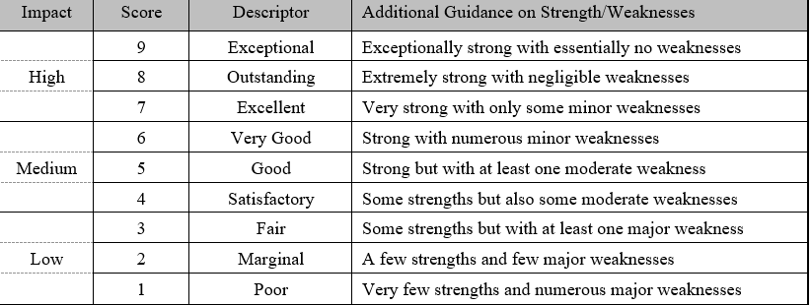
Scoring Scale & Guidelines

Slide 45
Questions?
aaofoundation.net

Slide 46
Guide to the 2024 Cycle for Applicants & Mentors
Workshop Goals
AAOF Mission & Achievements
Award Types & Eligibility Criteria
11 Required Components
Review Process & Criteria
Your Role & Your Mentors’/Chair’s Roles in Ensuring Your Success
Questions & Answers

Slide 47
Where Do Applicants Trip Up
Quality of application
How strong is it in each of the criteria?
Is it proposing novel ideas and approaches?
Does the application test a hypothesis?
Formatting & completeness of application
Did you submit by the deadline?
Did you follow the instructions diligently?
Are all required materials included?
If reworking a previous non-AAOF application:
Reformat to the AAOF guidelines

Slide 48
Where Do Applicants Trip Up
Award category
Are you eligible for the category for which you have applied?
Is this the category in which you are most competitive?
Accomplishments from prior funding
Did you achieve the goals of your previous funding?
Have you filed your reports with the AAOF?

Slide 49
Where Do Applicants Trip Up
Mentorship & Consultants
Important to seek
Strong, relevant mentors/consultants
Input early and often
Mentors/Consultants
Need to review application and provide input to ensure
Application is correctly written and compiled
Research question is strong and current

Slide 50
Best Practices
Start 6 months prior to submission
Awards Materials typically posted by July 1
www.aaofoundation.net
Research: Define excellent & novel
Questions
Experimental design
Contemporary, appropriate methodologies
Provide any preliminary data to support your ideas
For career development
Seek out new approaches to designing curriculum and teaching methods
Take relevant courses, workshops and classes

Slide 51
Best Practices
Mentorship
Strong, supportive and dedicated mentorship in research, teaching and career development
Application Refinements
Present and discuss your proposals with your mentors and consultants frequently, have them read/revise them
Have you done all your own work?
Complete well organized proposal
Attention to detail
Make it easy for the reviewers
Will reviewers have to search for needed information?
Place content where it should be

Slide 52
Awards Types for 2024
Junior Faculty
OFDFA
PFA
BRA
≥3 years of full-time academics
Center Award
Research Aid Award
Orthodontic Faculty Development Fellowship Award
Postdoctoral Fellowship Award
Biomedical Research Award

Slide 53
Awards Not Offered in 2024
Education Innovation Award (EIA)

Slide 54
The Future
Continue building on
Quality of applications
Discoveries in orthodontics
Faculty development successes
New processes for identifying Calls for Proposals
Continue enhancing quality of review and feedback
Implementation of AAOF Strategic Plan

Slide 55
Looking for
Novel Projects
AAOF would like to fund more “novel” Research and Development projects
Over the years development has been slow
Machine learning (ML) is on the rise and should be explored
With the aid of ML, instruments can report on intraoral conditions such as, periodontal changes, soft tissue compliance and behavior, appliance malfunctions, in addition to somatic growth status with comparisons to initial diagnosis, and planned treatment mechanics
Artificial Intelligence (AI) can work together with ML
AI-facilitated planning for qualitative treatment mechanics in 3D is possible while ML could “qualitatively” assess the conditions the patient presents, and to design the mechanotherapy
Could be instrumental in doing marketing, based on patients’ persona and preferences for behavior, services and esthetics

Slide 56
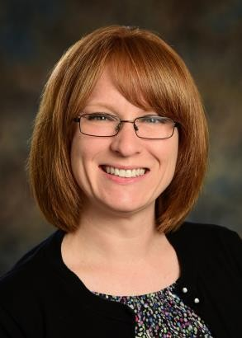
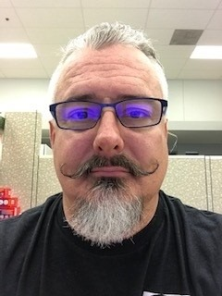
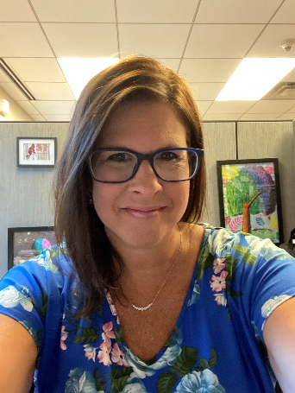
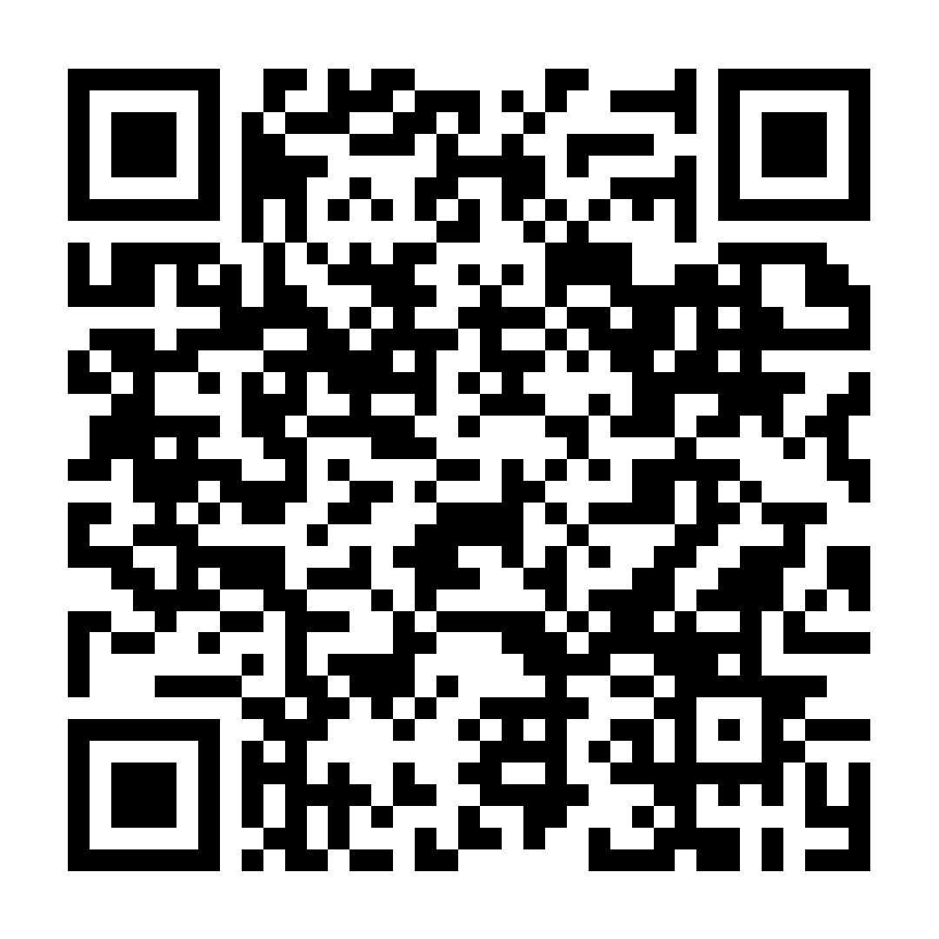
Questions?
For more information contact:
Jackie Bode, MA, CFRE, AAOF Senior Vice President jbode@aaortho.org 800.424.2841 (#546)
Jackie Bode
George Reinarman
Mindy Copp
https://www.aaofoundation.net/awards-program/about-the-aaof-awards-program

